Slide 1




A Sidescroller Game by Ted‘s Entertainment
Notes:
MIchaela

Slide 2

Agenda
Business Cases / Preparation
Implementation and Quality
Testing
Demo
Notes:
Michaela

Slide 3



Reflect Idea
Sidescroller game
Main character
Enjoyable and simple game
01.07.2020
1
Notes:
Michaela

Slide 4
Business Cases / Preparation
Notes:
Gabriel

Slide 5
RUP
Phases:
Inception
Elaboration
Construction
Transition
Disciplines:
Environment
Project Management
Test
Implementation
Analysis & Design
01.07.2020
3
Notes:
Gabriel

Slide 6
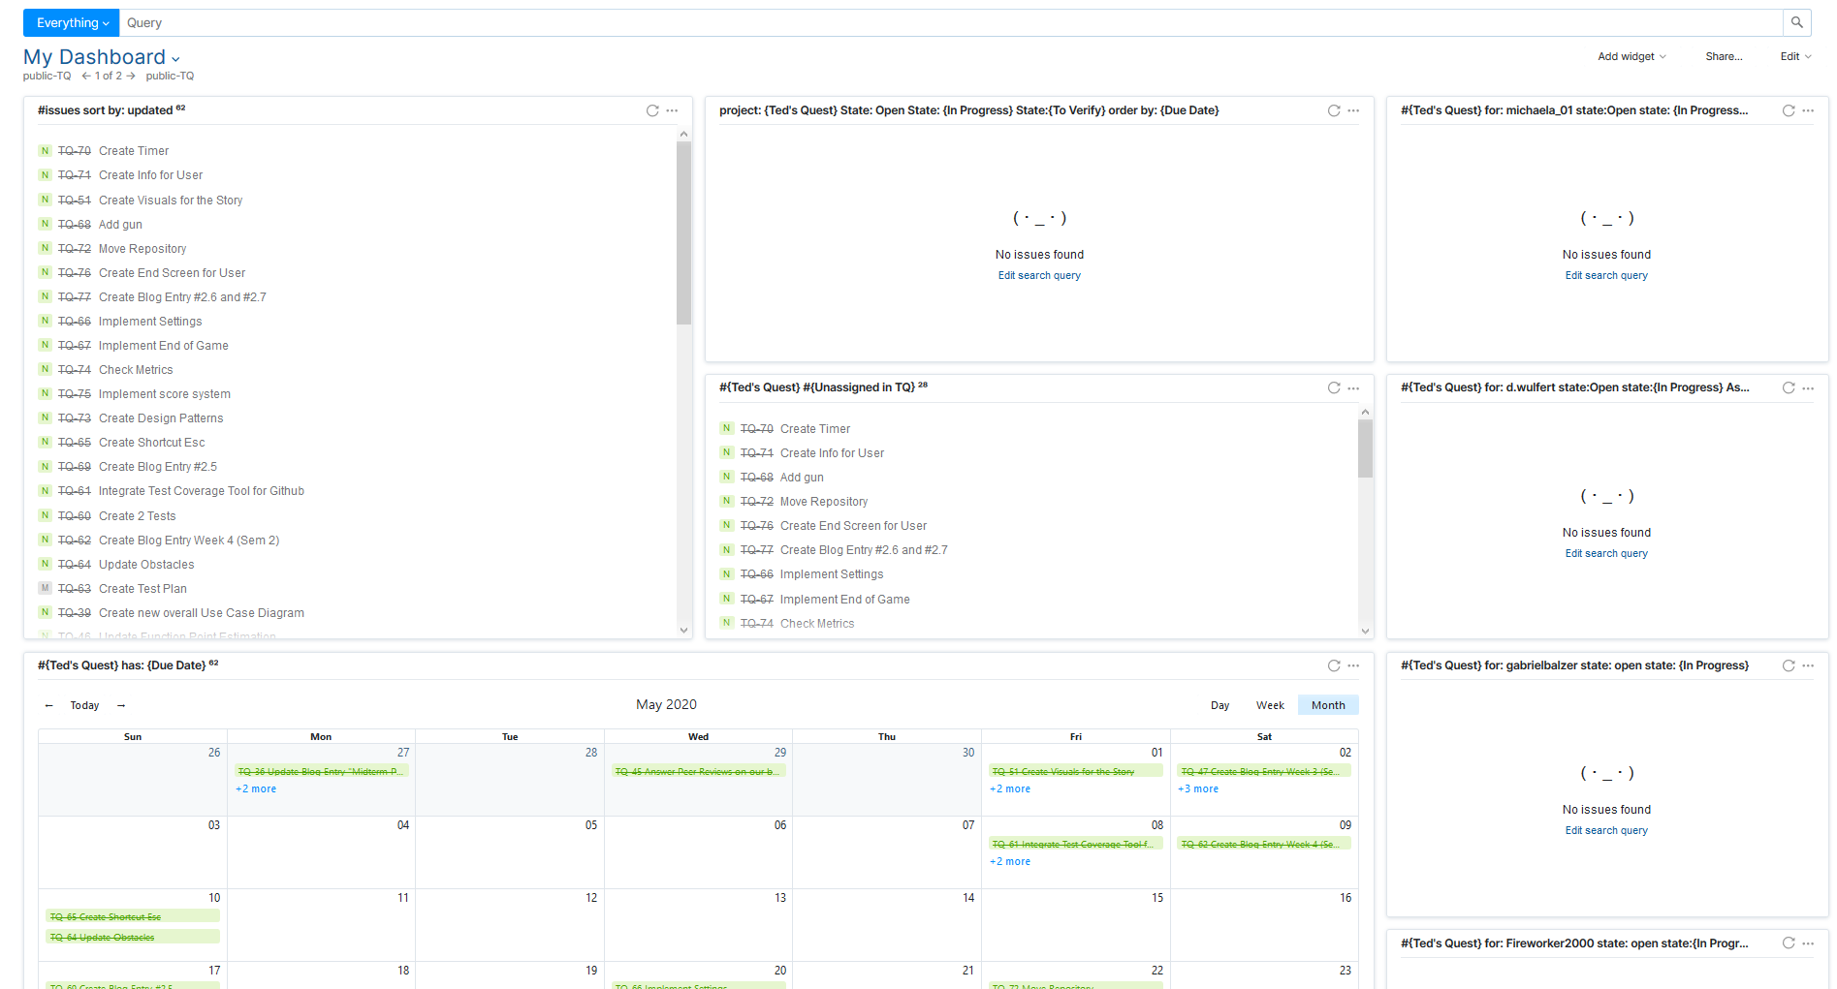
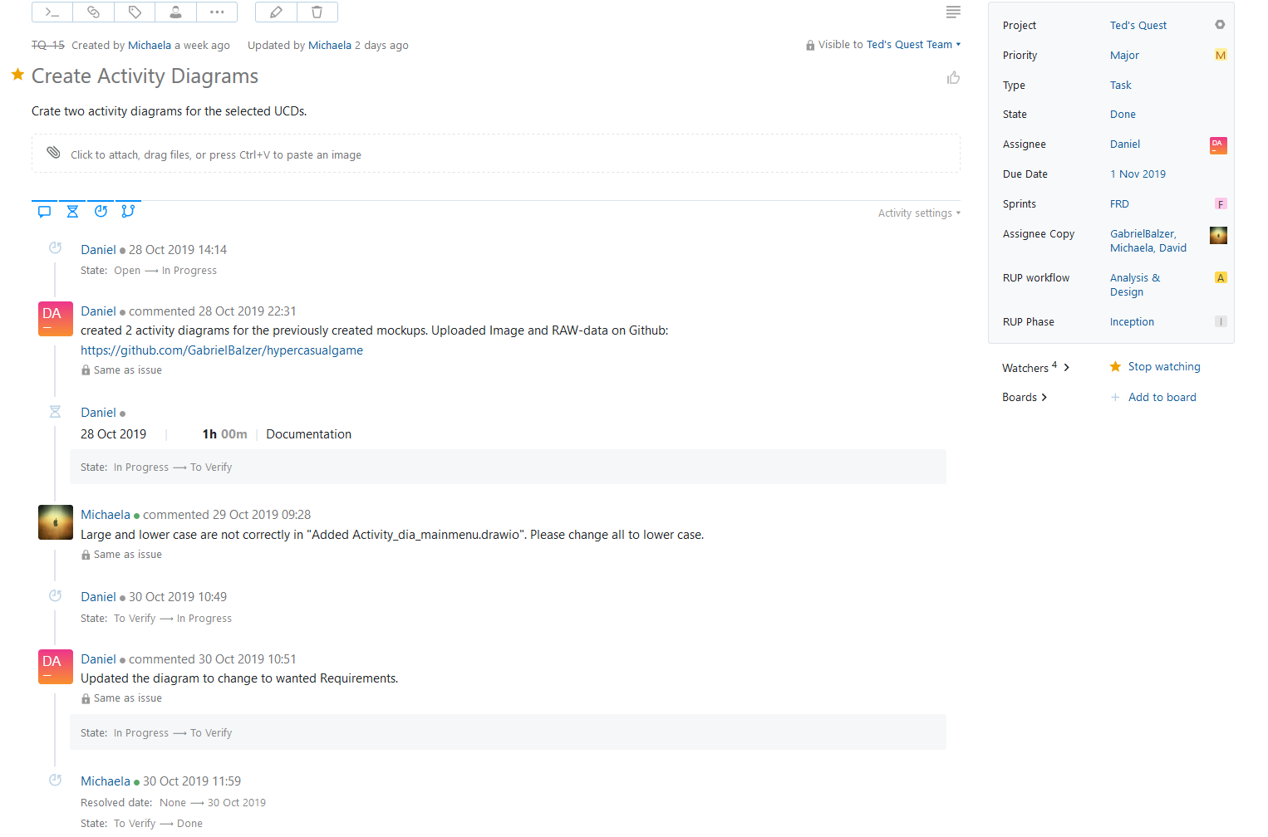
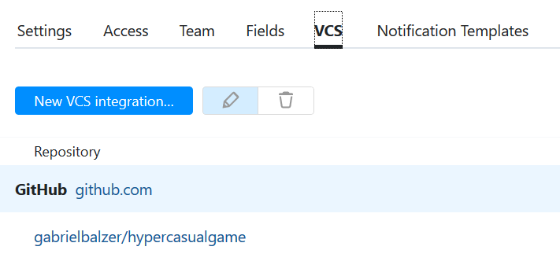
Management Methods – YouTrack
01.07.2020
4
Notes:
Gabriel

Slide 7
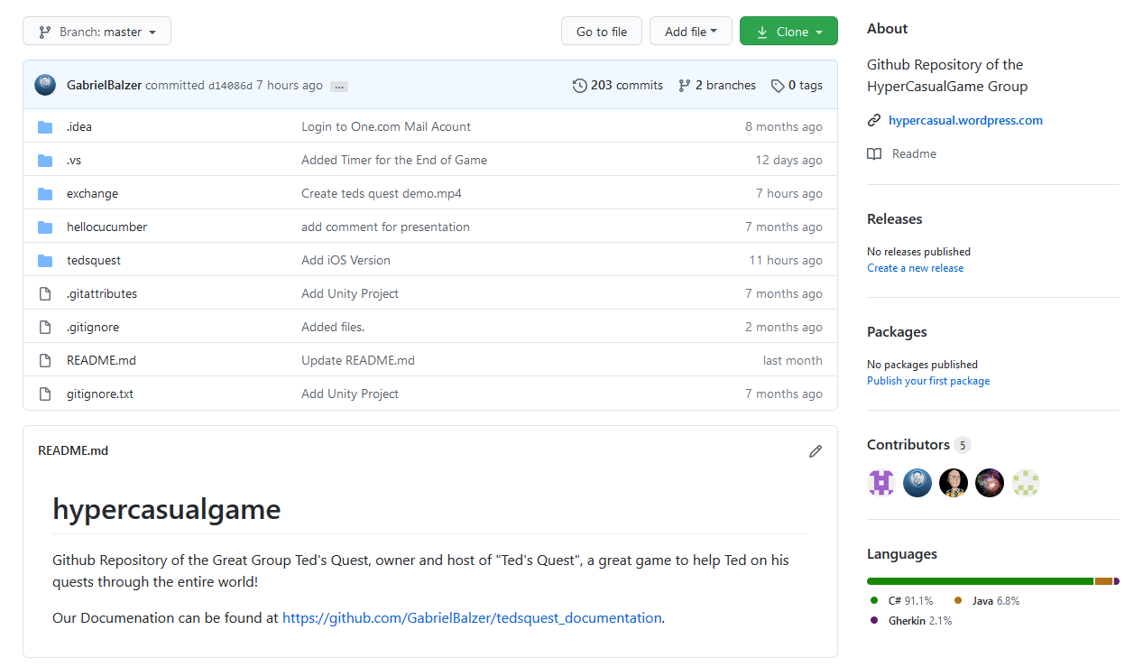
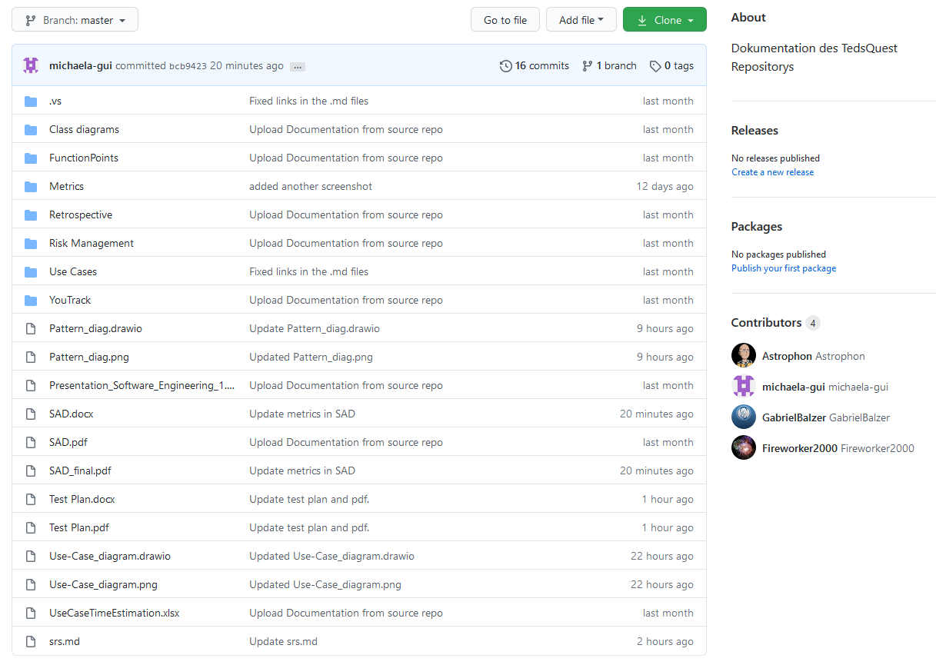
Management Methods - GitHub
01.07.2020
5
Notes:
Gabriel

Slide 8
SAD and SRS
01.07.2020
6
Notes:
Gabriel

Slide 9
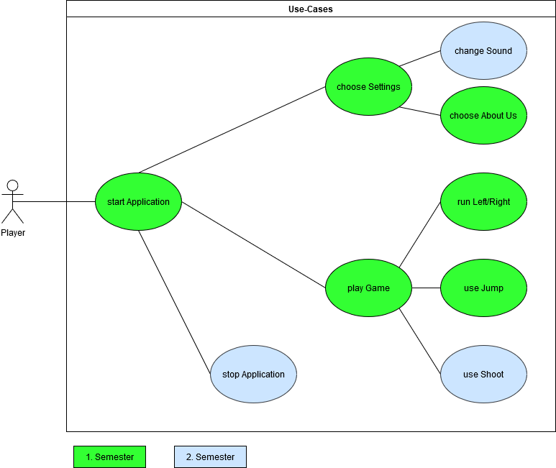
Scope – Overall Use Case Diagram
01.07.2020
7
Notes:
Daniel

Slide 10
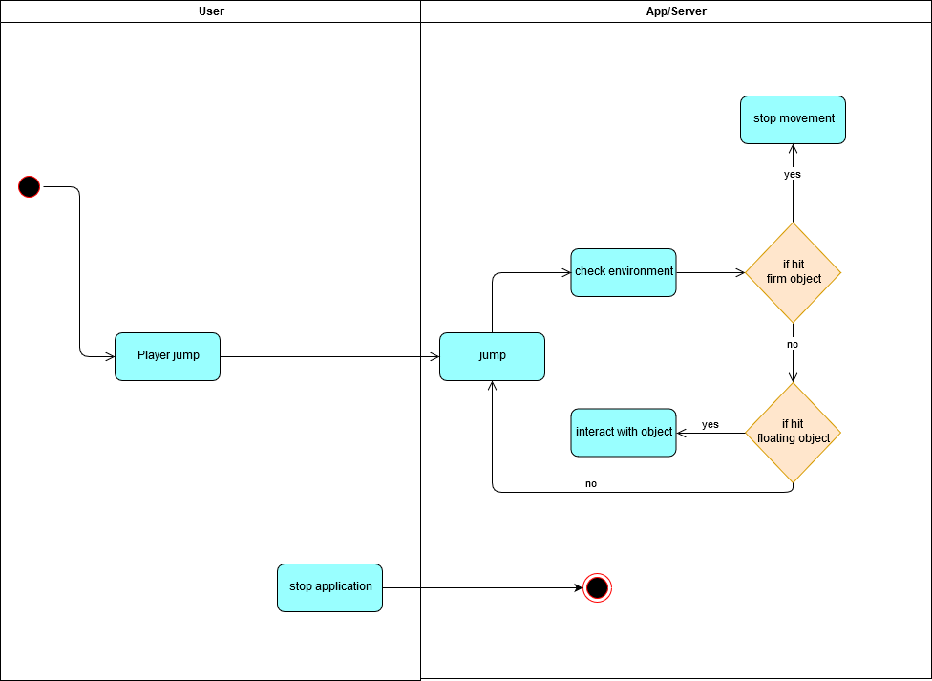
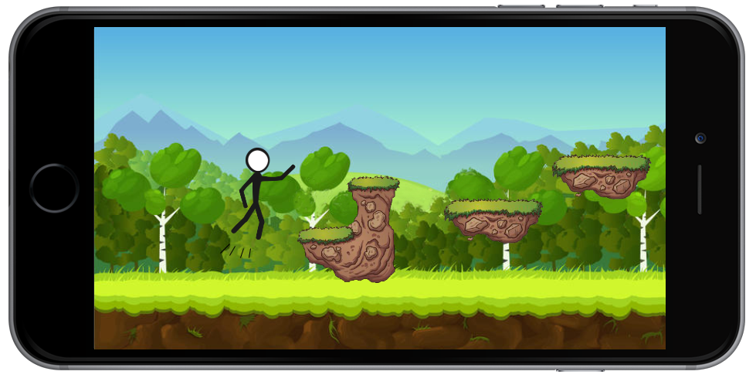
Use Case Jump
01.07.2020
8
Notes:
Daniel

Slide 11
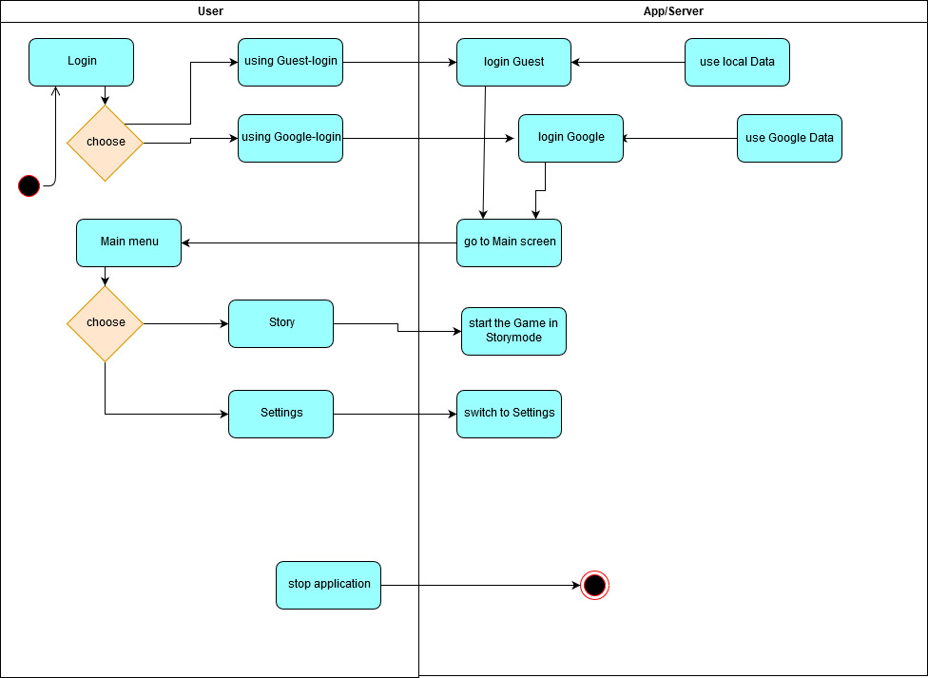
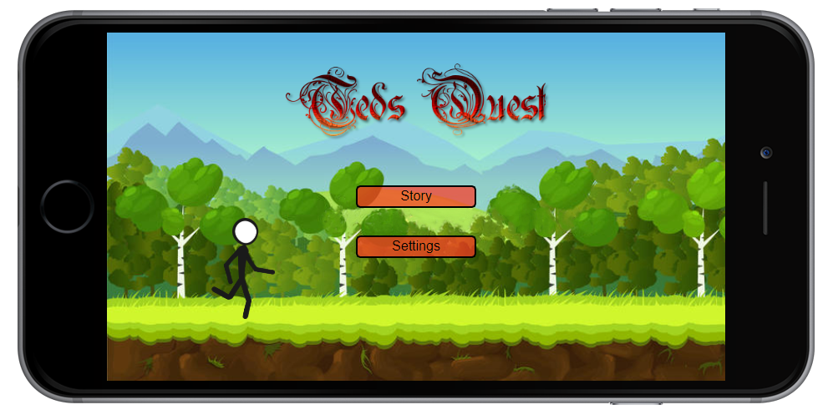
Use Case Main Menu
01.07.2020
9
Notes:
Daniel

Slide 12

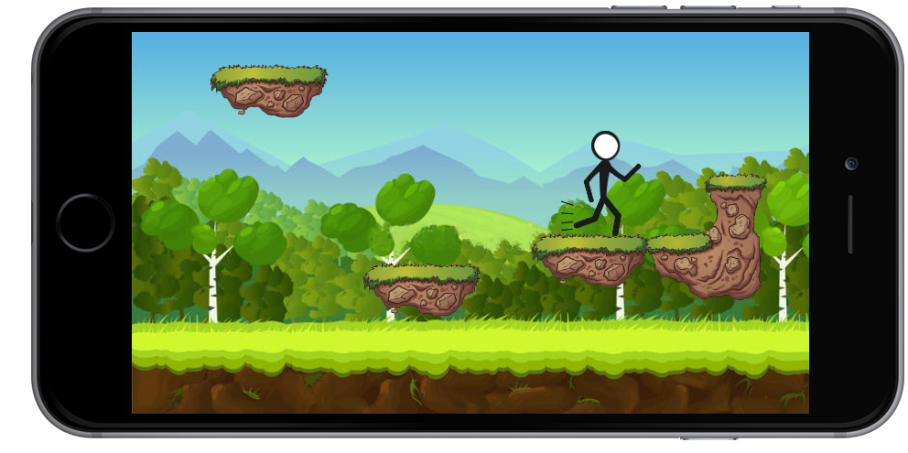
Use Case Move Right
01.07.2020
10
Notes:
Daniel

Slide 13
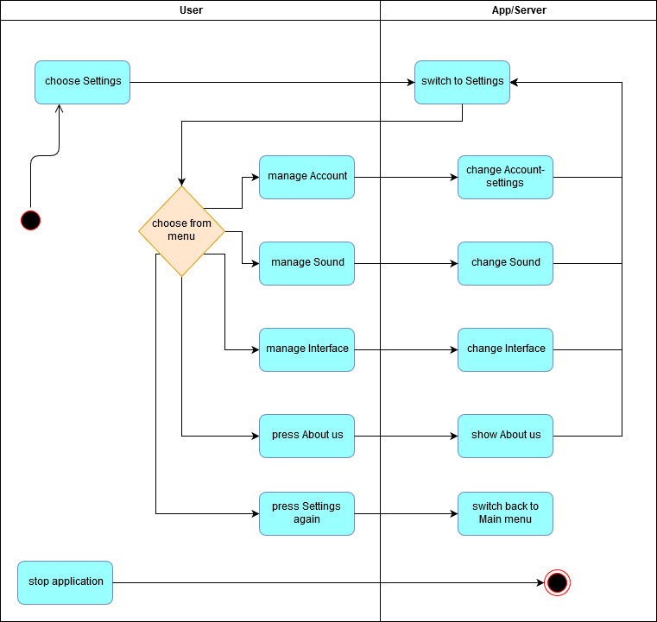
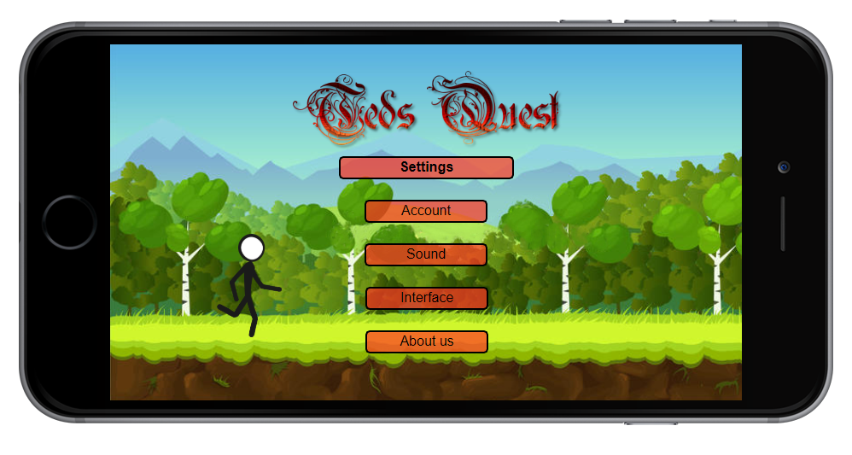
Use Case Settings
01.07.2020
11
Notes:
Daniel

Slide 14
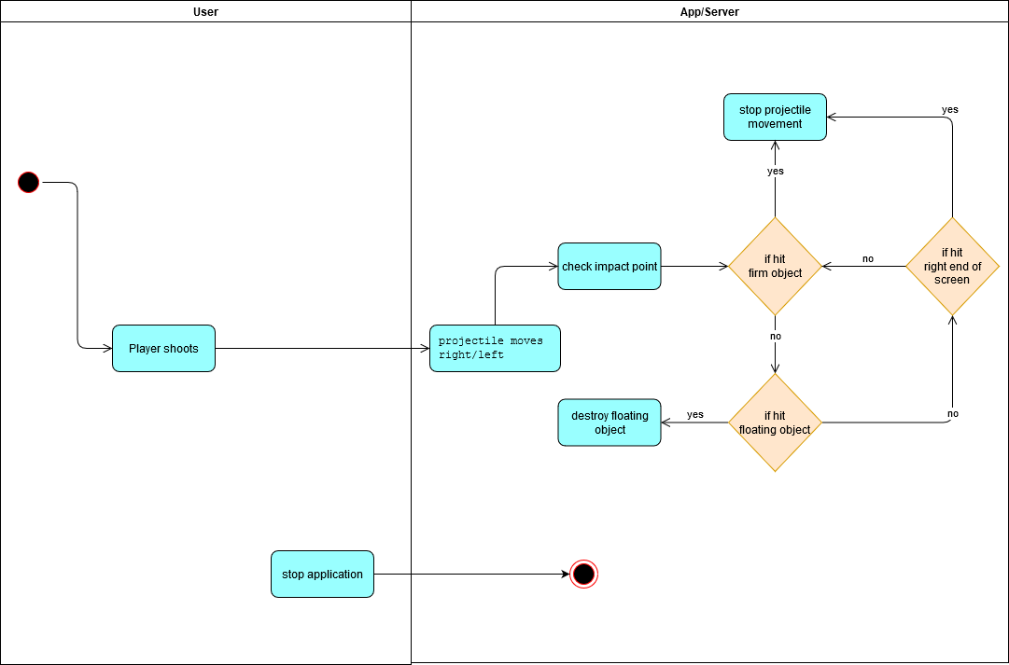
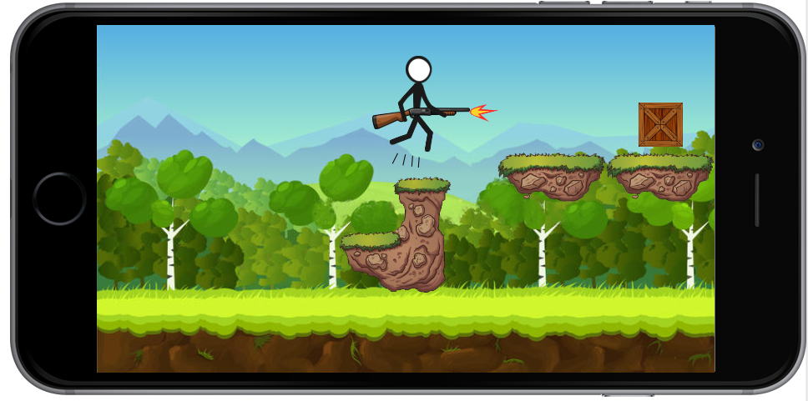
Use Case Shoot
01.07.2020
12
Notes:
Daniel

Slide 15
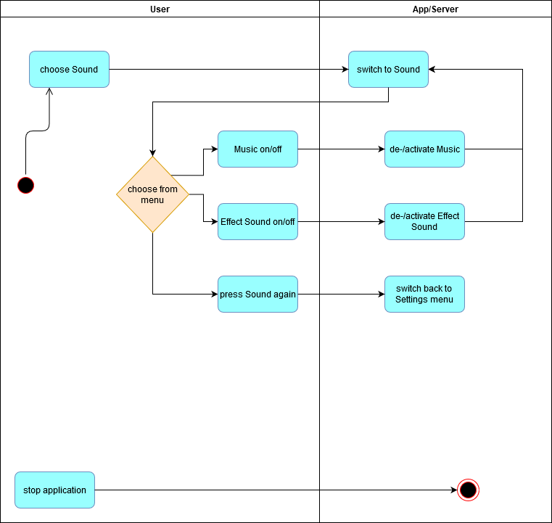
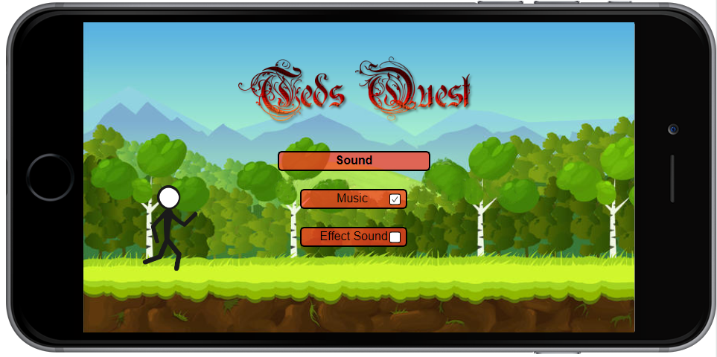
Use Case Sound Settings
01.07.2020
13
Notes:
Daniel

Slide 16
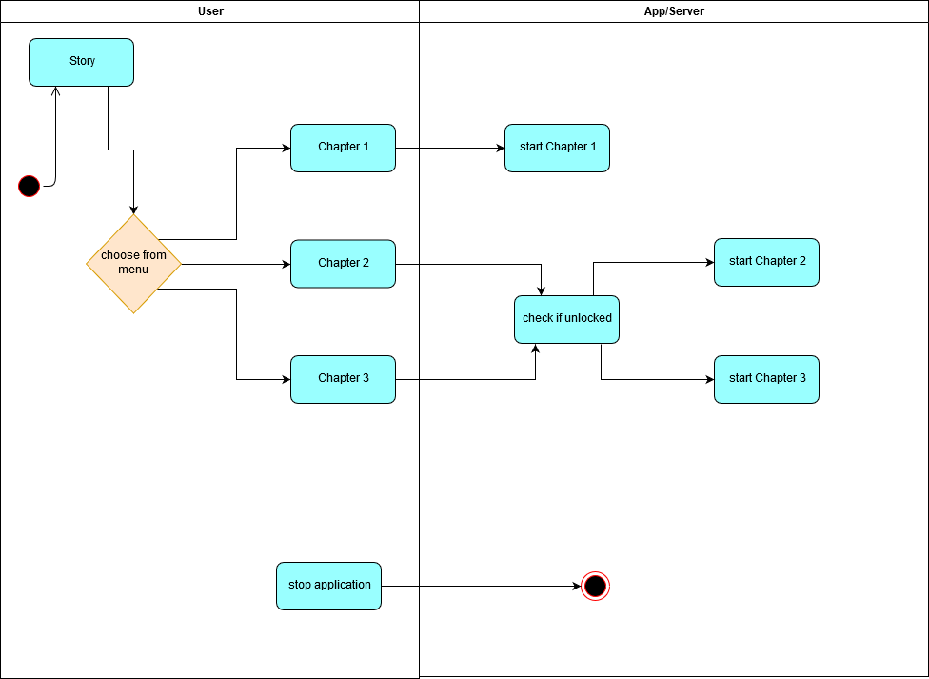
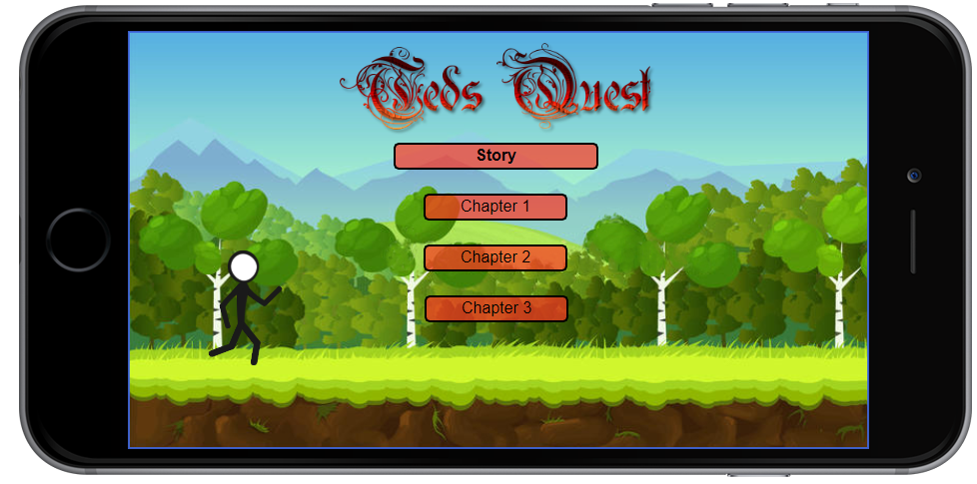
Use Case Story Menu
01.07.2020
14
Notes:
Daniel

Slide 17

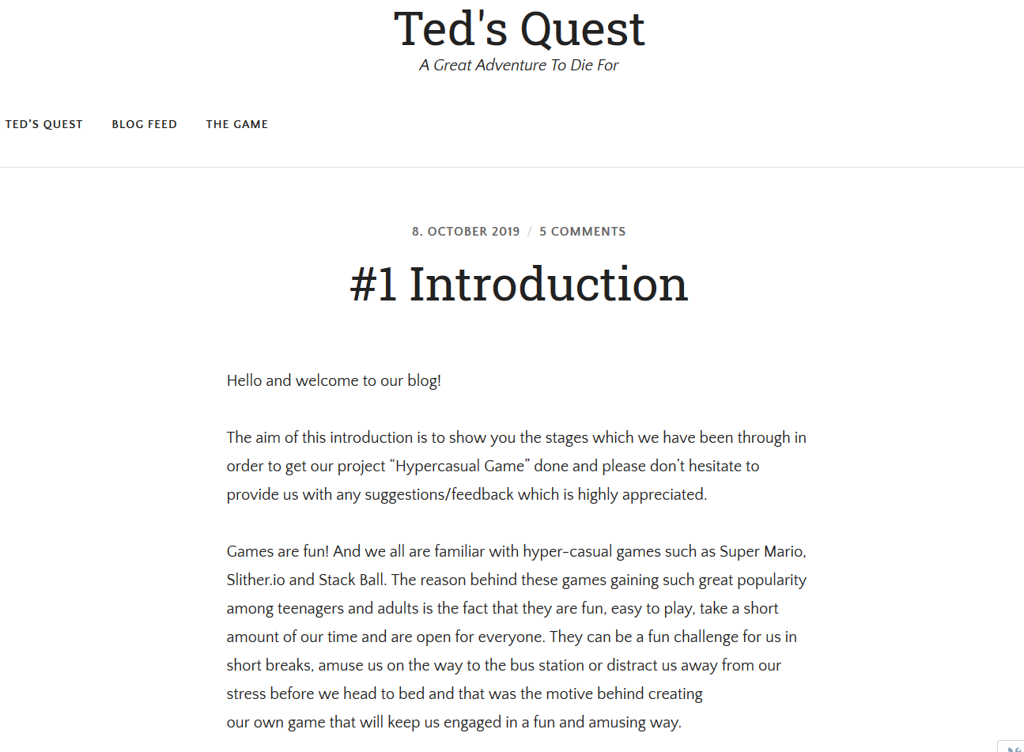
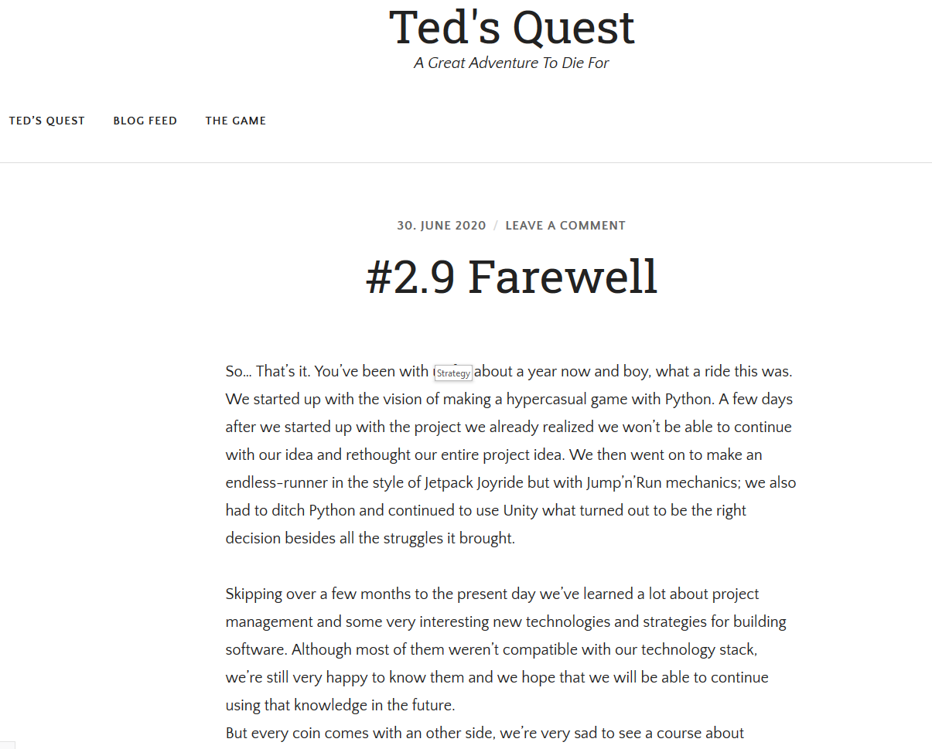
Blog
01.07.2020
15
Notes:
David

Slide 18

Risk Management
01.07.2020
16
Notes:
David

Slide 19

Strategy
First Level Development:
Game for Computer
1 manually crafted Levels
Second Level Development
Game for Android Smartphone
Infinite Mode
Additional manually crafted Levels
Third Level Development
Automatically generated Levels
Store for Clothing and Weapons
https://ak5.picdn.net/shutterstock/videos/7060045/thumb/3.jpg
01.07.2020
17
Notes:
Michaela

Slide 20
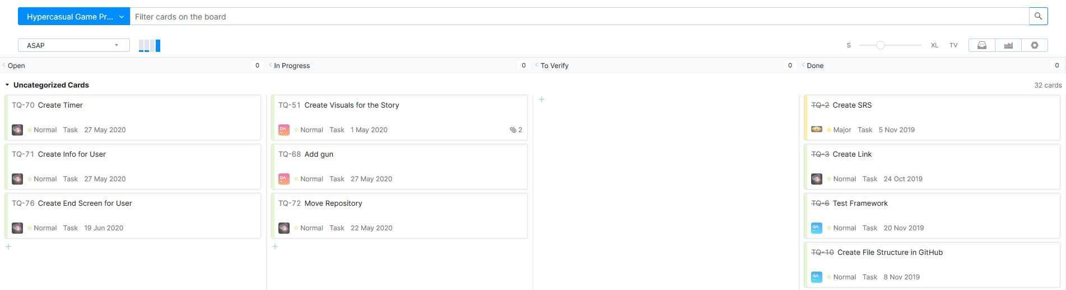
RUP als Modell
Agility
Scrum-based
01.07.2020
18
Notes:
Michaela

Slide 21
Implementation and Quality
Notes:
Daniel

Slide 22
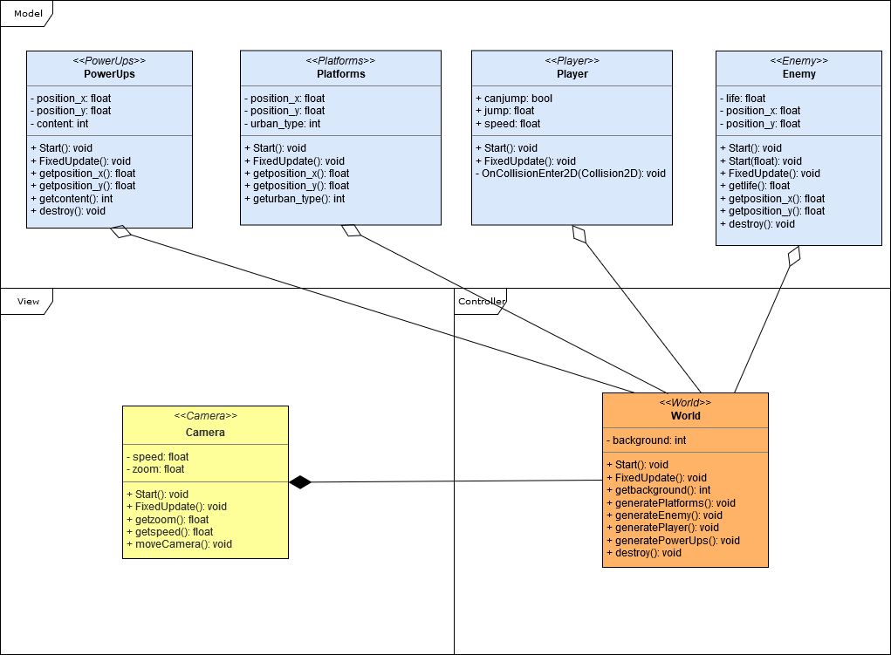
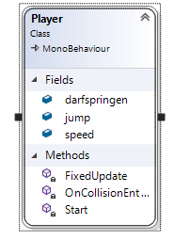
Technical Aspects
01.07.2020
20
Notes:
Daniel

Slide 23
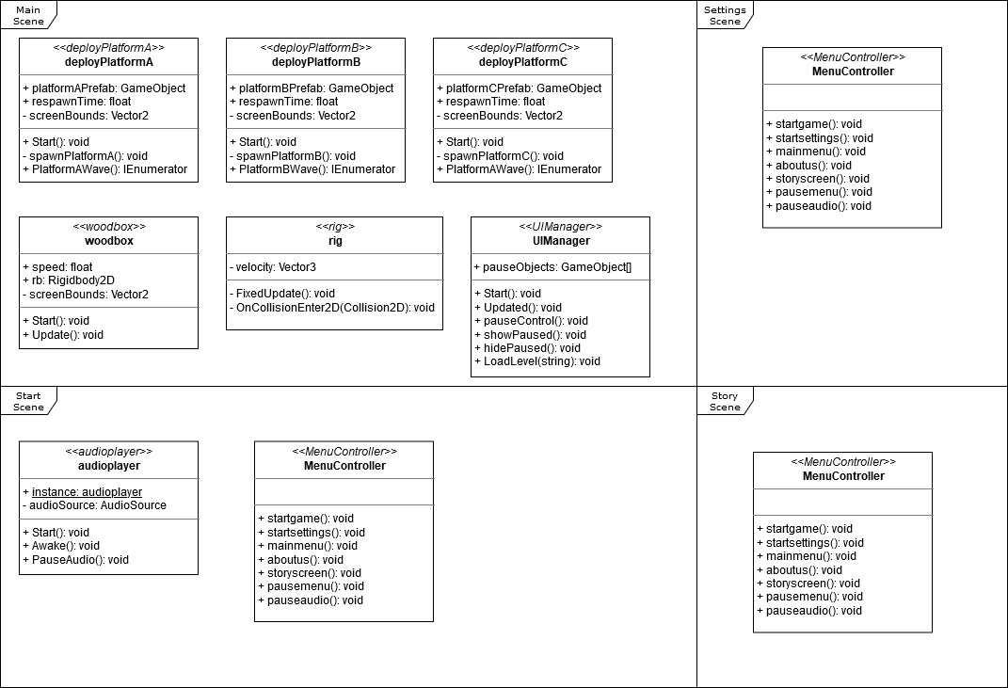
Class Diagram
01.07.2020
21
Notes:
Daniel

Slide 24
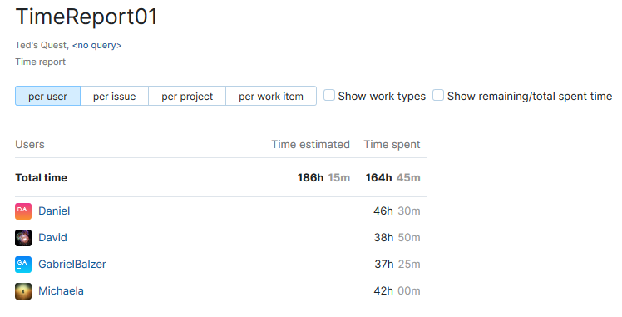
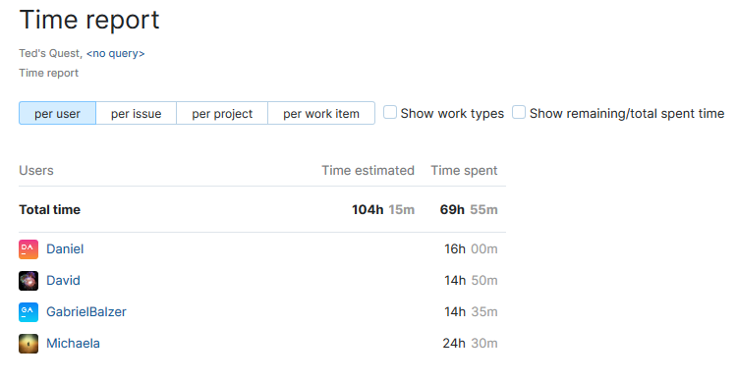
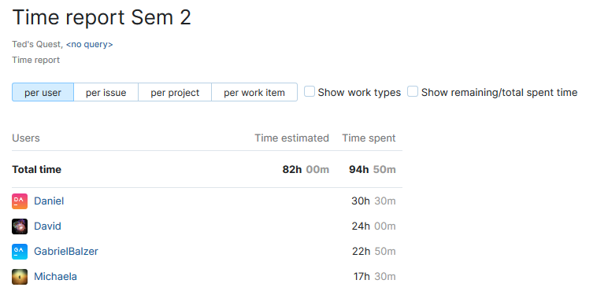
Workload per User
Semester 1
Semester 2
01.07.2020
22
Notes:
Michaela

Slide 25
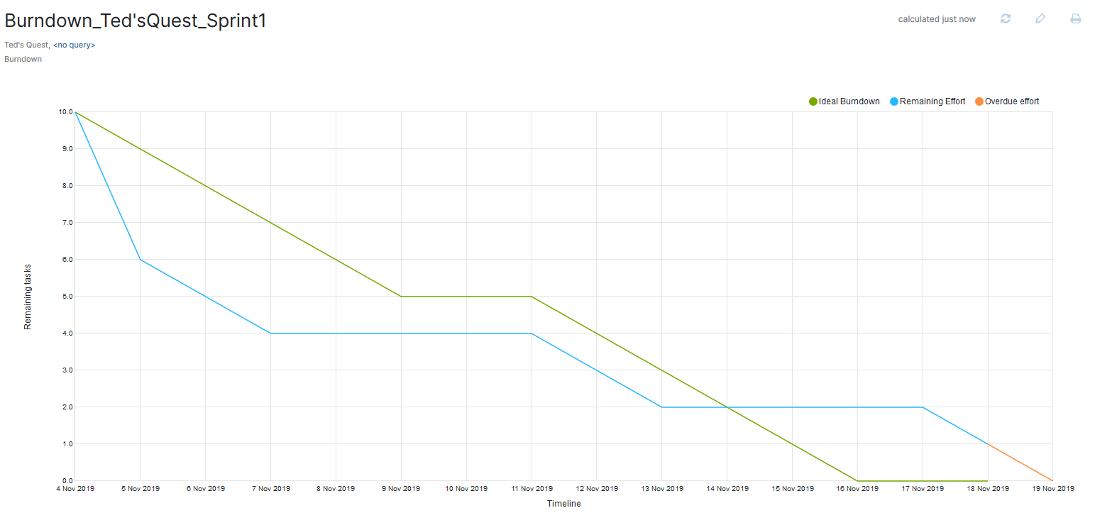
Burndown Time-Management per Issue
01.07.2020
23
Notes:
Michaela

Slide 26
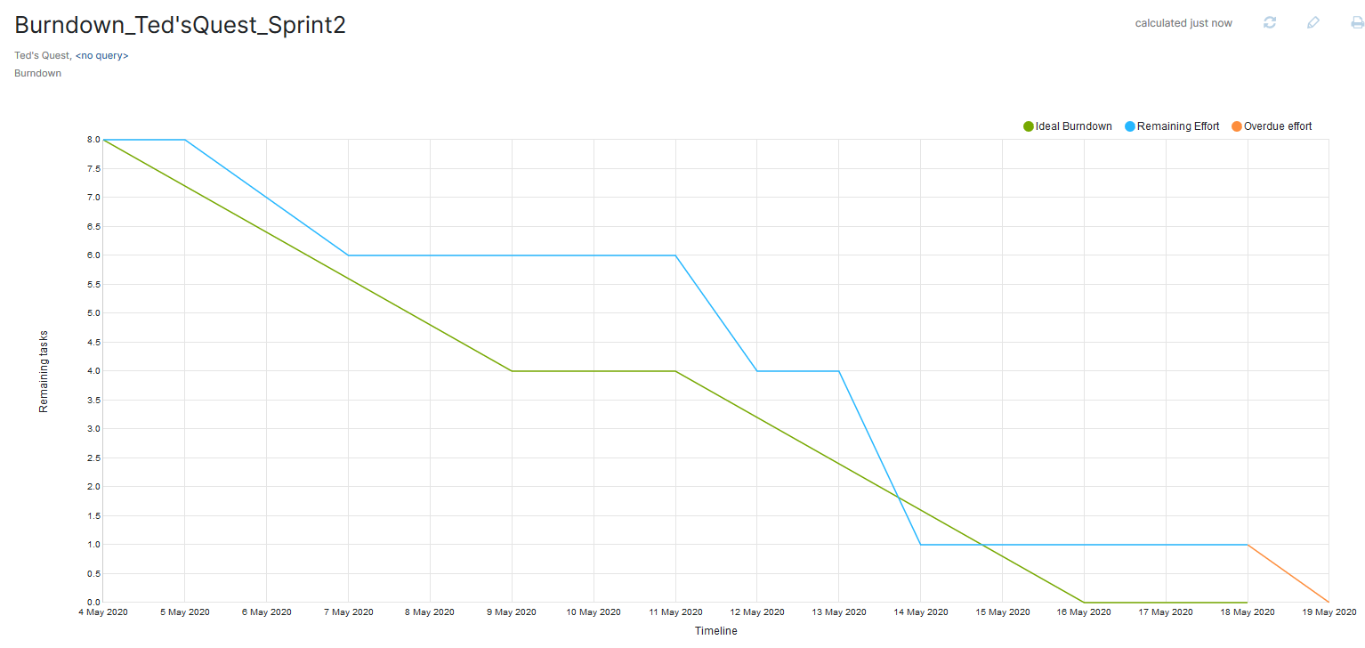
Burndown Time-Management per Issue
01.07.2020
24
Notes:
Michaela

Slide 27
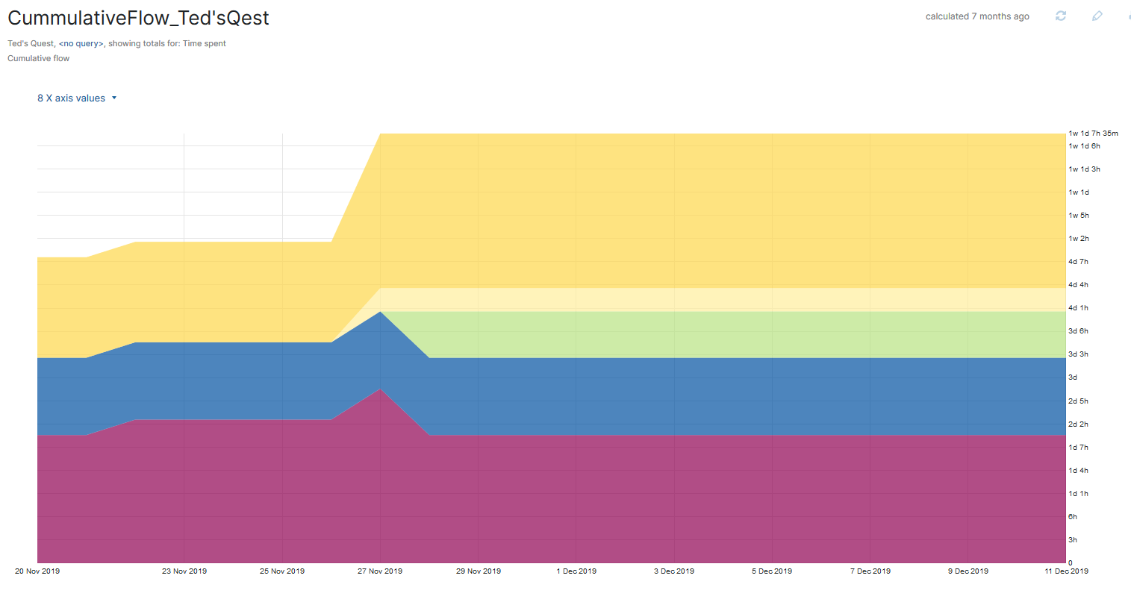
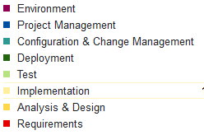
Cumulative Flow Diagram
01.07.2020
25
Notes:
Michaela

Slide 28
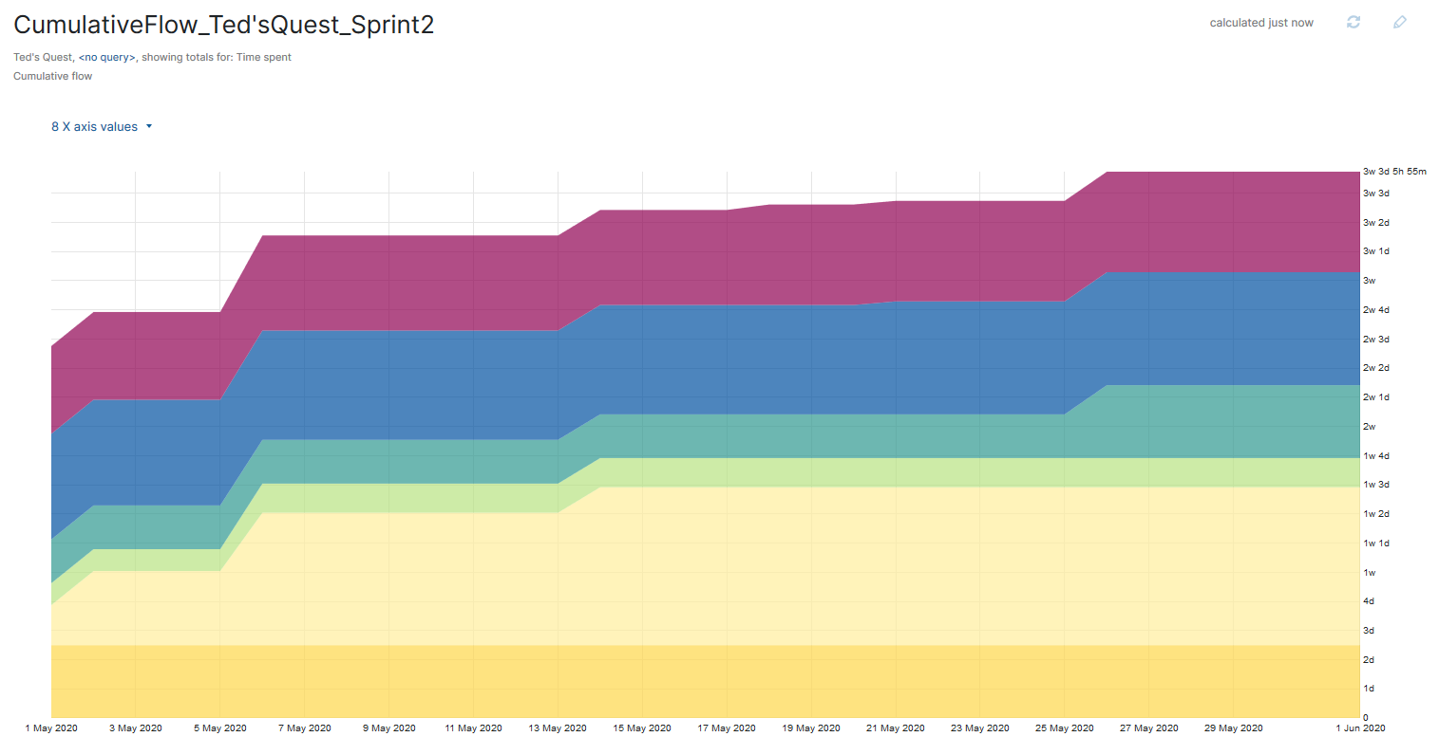
Cumulative Flow Diagram
01.07.2020
26
Notes:
Michaela

Slide 29
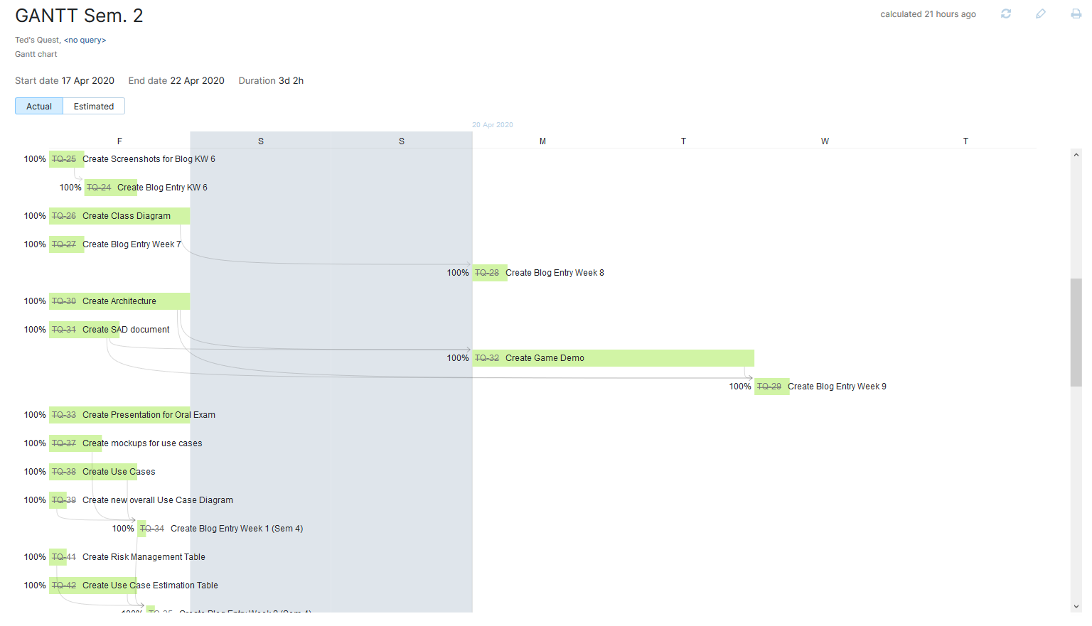
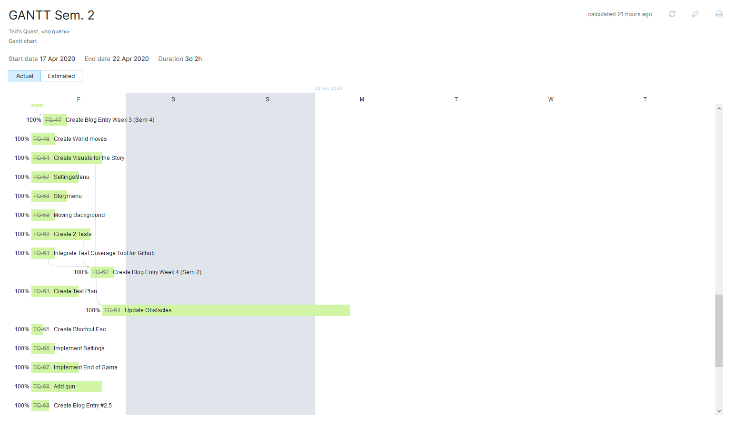
Gantt Chart
01.07.2020
27
Notes:
Michaela

Slide 30
Testing
Notes:
Gabriel

Slide 31
Function Points
01.07.2020
29
Notes:
Gabriel

Slide 32
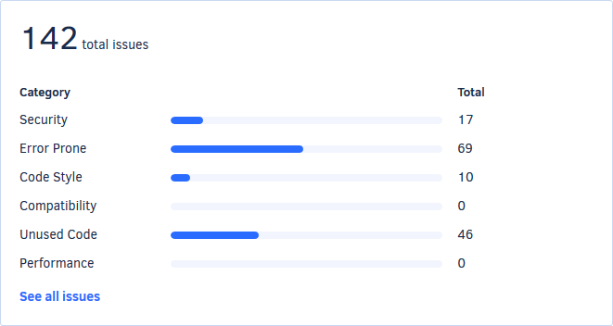
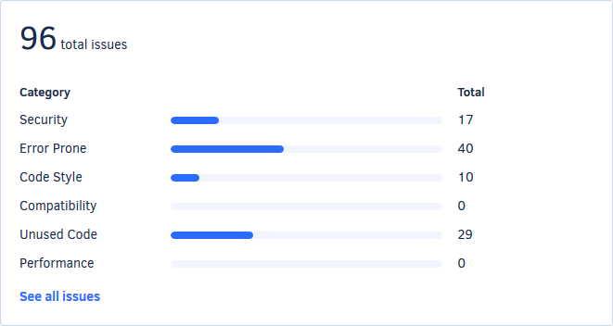
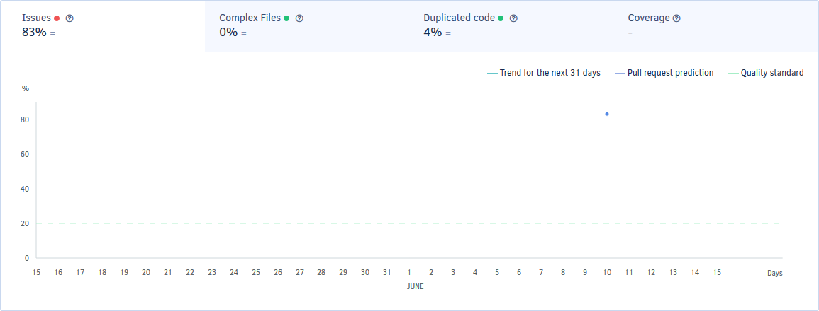
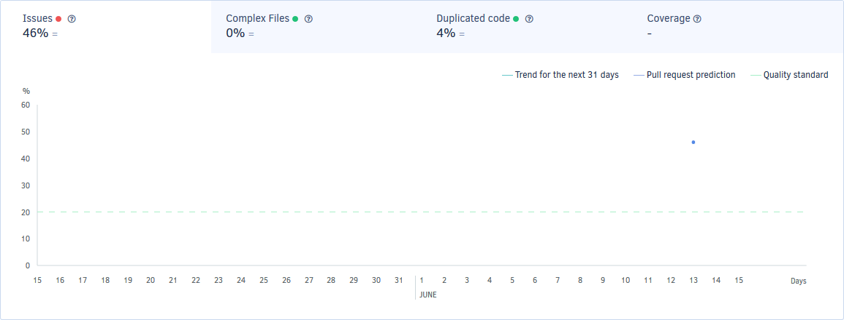
Metrics
Before Codacy
After Codacy
01.07.2020
30
Notes:
Gabriel

Slide 33
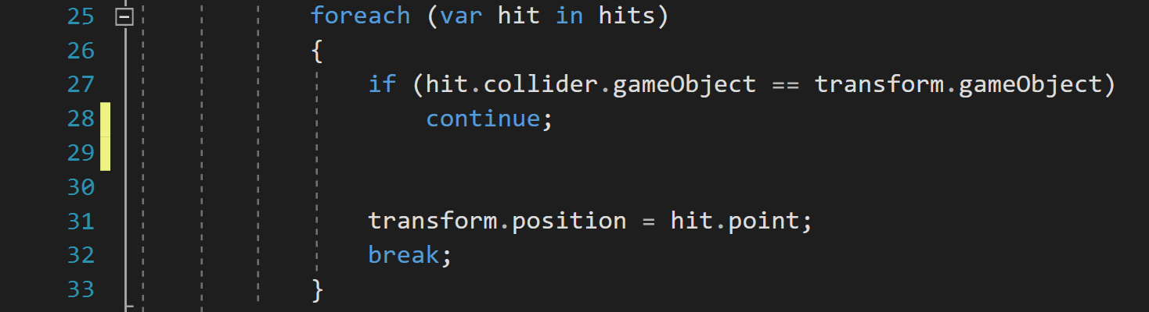
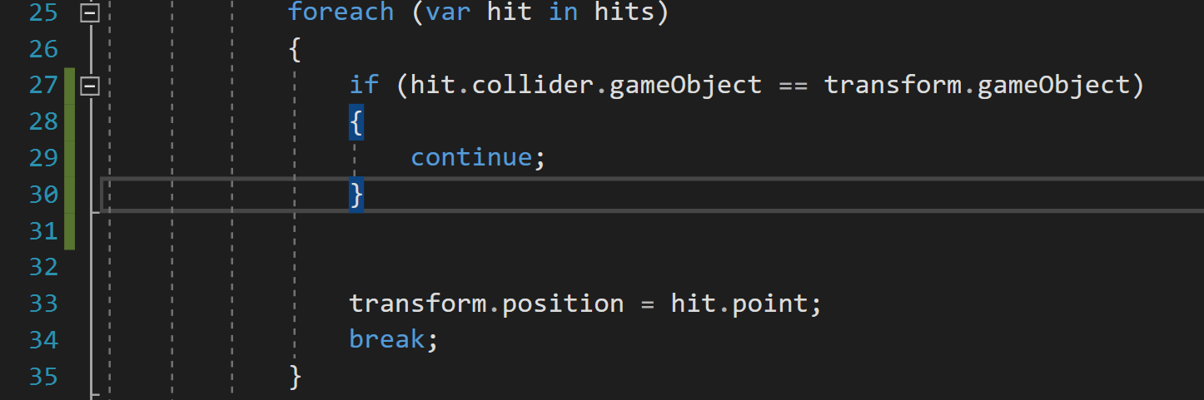
Metrics
Before
After
01.07.2020
31
Notes:
Gabriel

Slide 34
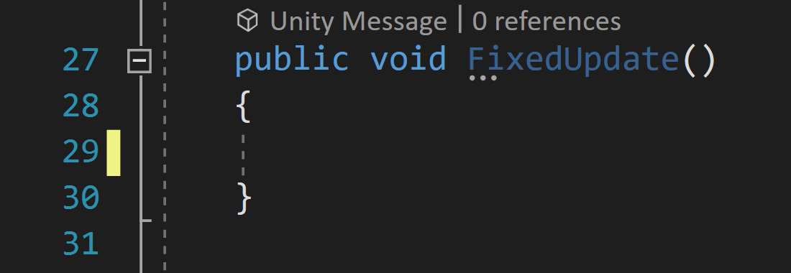
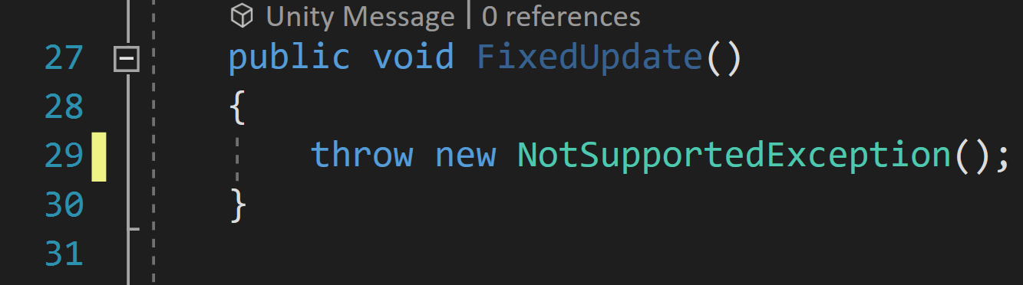
Metrics
Before
After
01.07.2020
32
Notes:
Gabriel

Slide 35
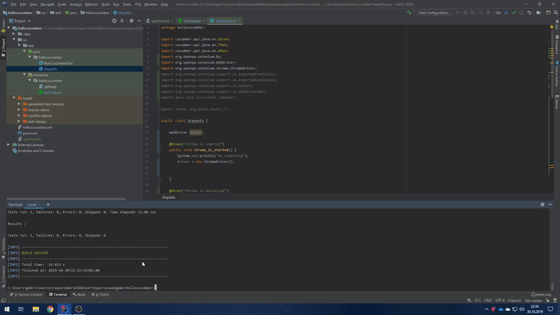
Testing – feature files
01.07.2020
33
Notes:
Gabriel

Slide 36
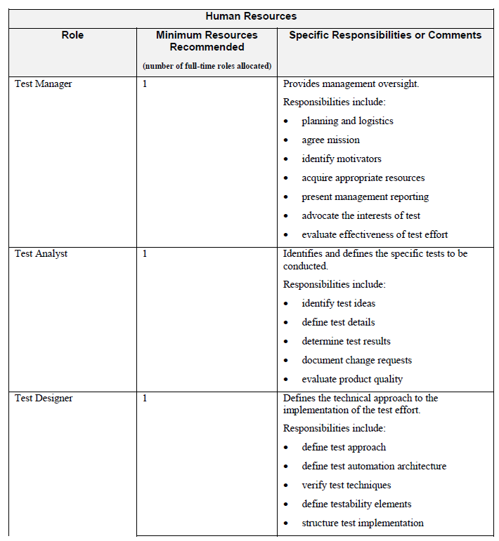
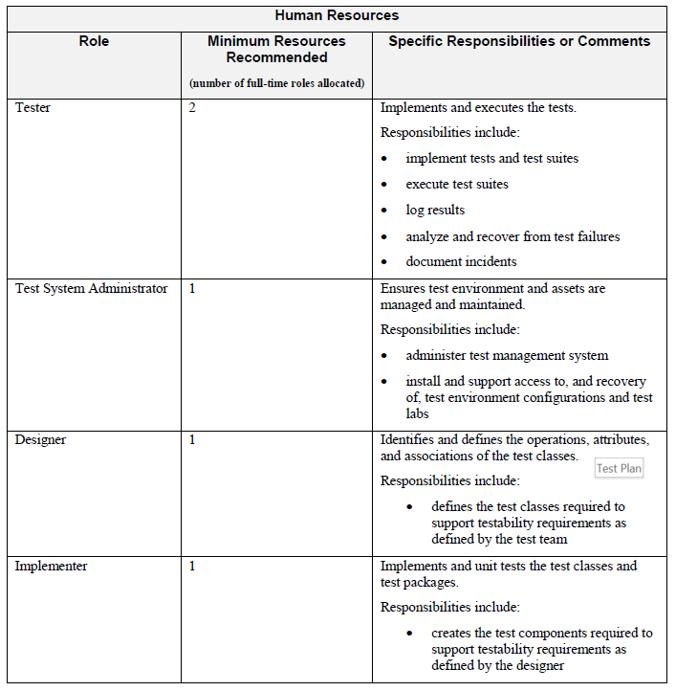
Test Plan
01.07.2020
34
Notes:
David

Slide 37
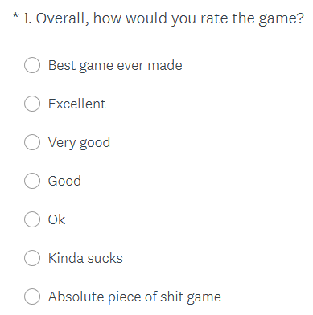
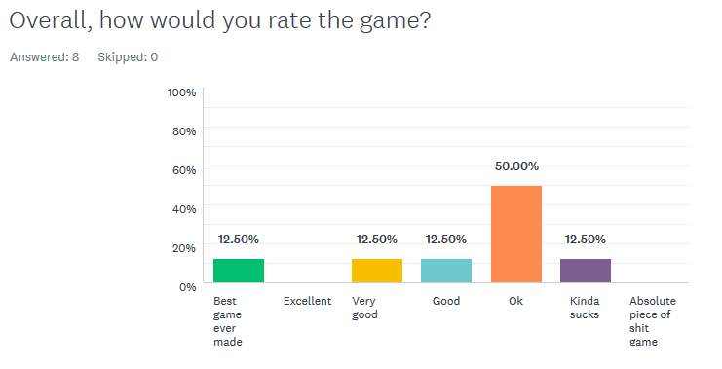
User Testing – Survey
Question
Result
01.07.2020
35
Notes:
David

Slide 38
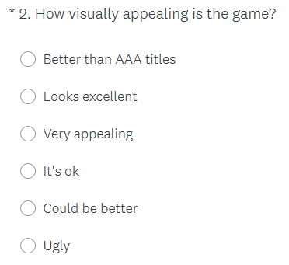
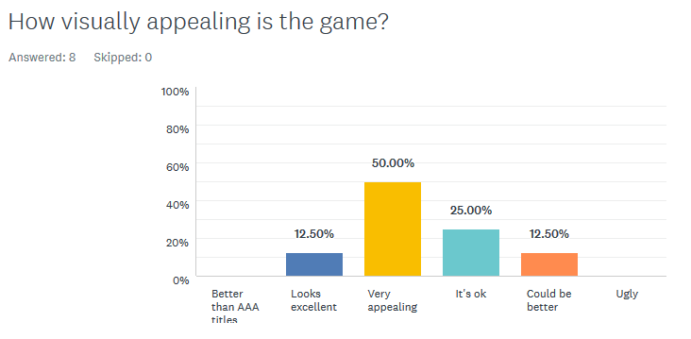
User Testing – Survey
Question
Result
01.07.2020
36
Notes:
David

Slide 39


User Testing – Survey
Question
Result
01.07.2020
37
Notes:
David

Slide 40



User Testing – Survey
Question
Result
01.07.2020
38
Notes:
David

Slide 41
Demo
Notes:
Gabriel

Slide 42

01.07.2020
40
Notes:
Gabriel

